Slide 1
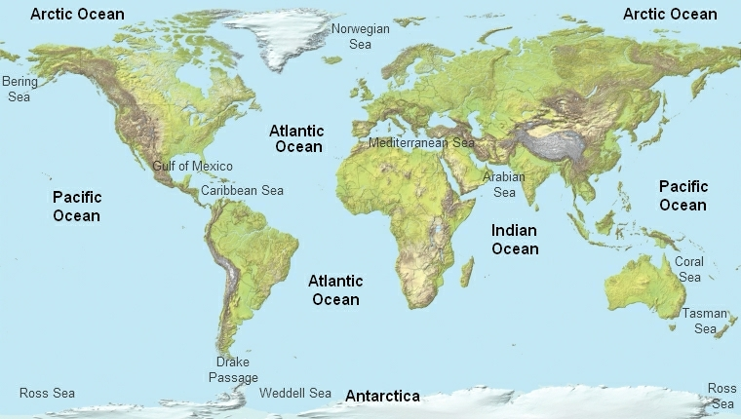
Chapter 12 The Oceans,
Coastal Systems, and Wind Processes

Slide 2
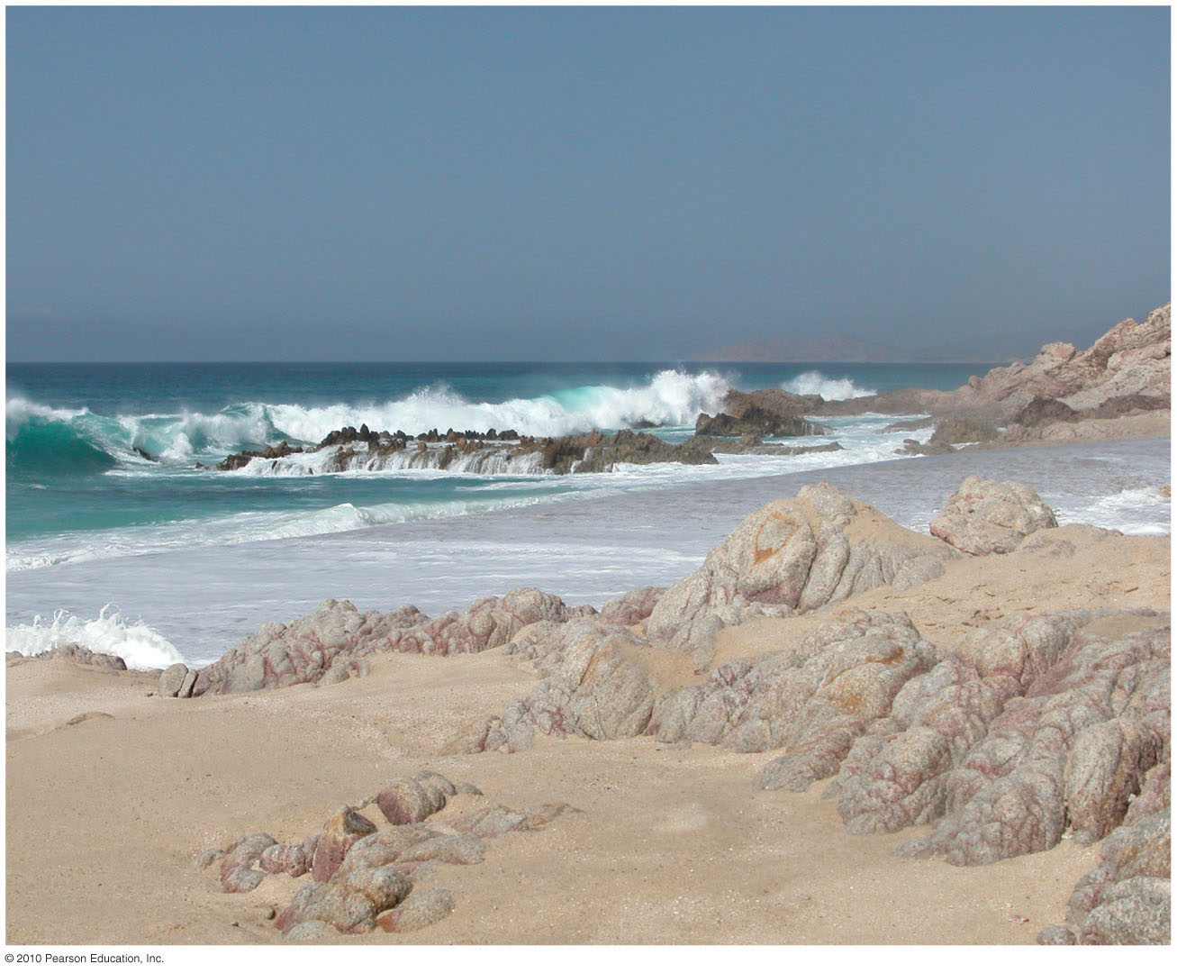
Coastal Landforms and Processes

Slide 3
The Oceans, Coastal Systems, and Wind Processes
Global Oceans and Seas
Coastal System Components
Coastal System Actions
Coastal System Outputs
The Work of Wind

Slide 4
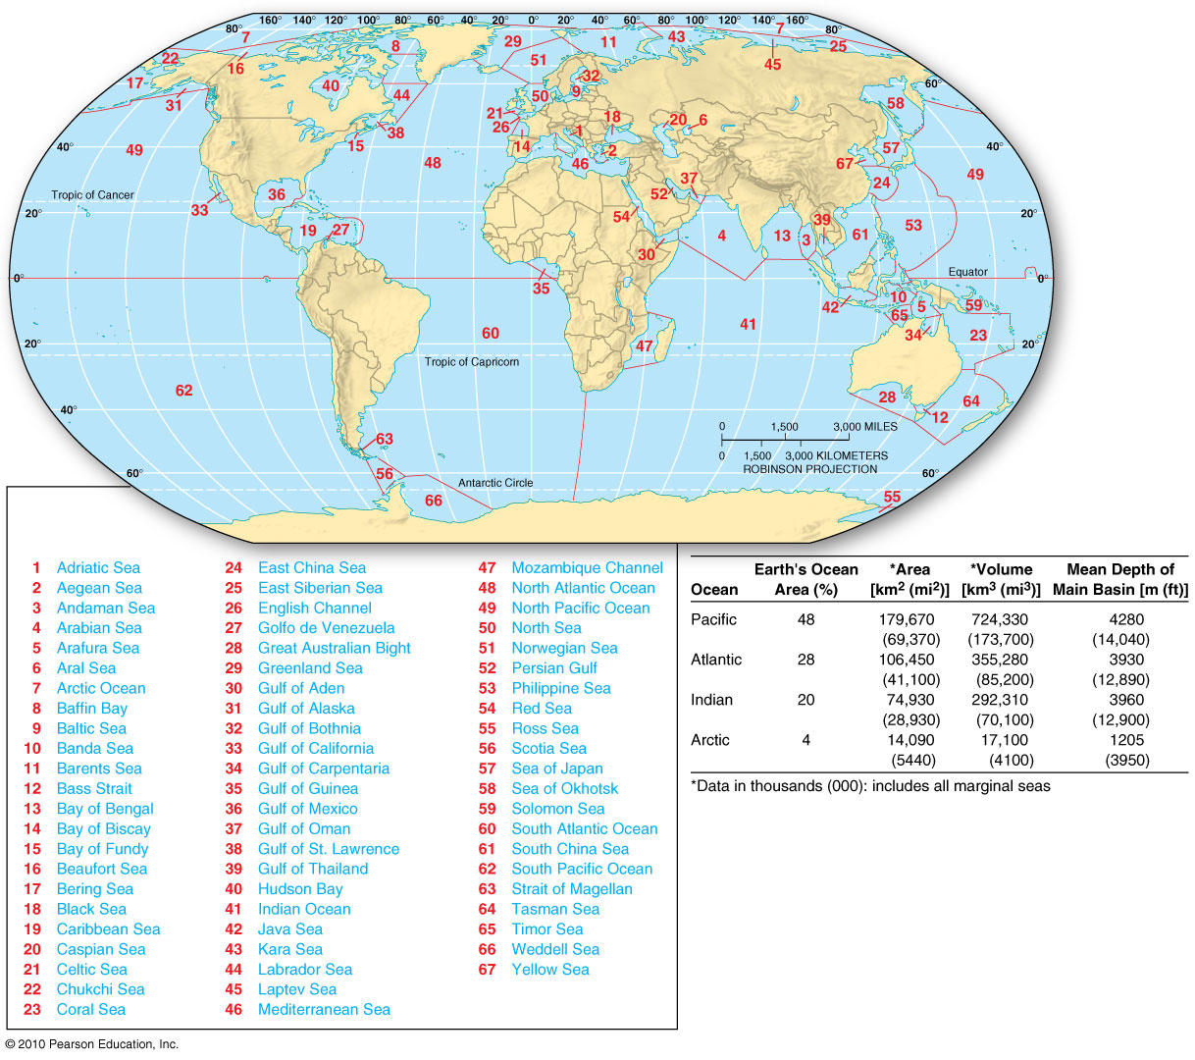
Figure 13.1
Christopherson, Elemental Geosystems, Sixth Edition
Copyright © 2010 Pearson Education, Inc.

Slide 5
Chemical Composition of Seawater
Chemical Composition of Seawater
Water acts as a solvent, dissolving at least 57 elements found in nature
Seawater is a solution; concentration of dissolved solids is called salinity
Ocean chemistry
Interaction of seawater, atmosphere, minerals, bottom sediments, and living organisms
Mineral-rich water enter the ocean through hydrothermal vents (black smokers) in the ocean
Uniformity of seawater
7 elements account for more than 99% of dissolved solids in the sea (Cl, Na, Mg, SO₄, Ca, K, Br)

Slide 6
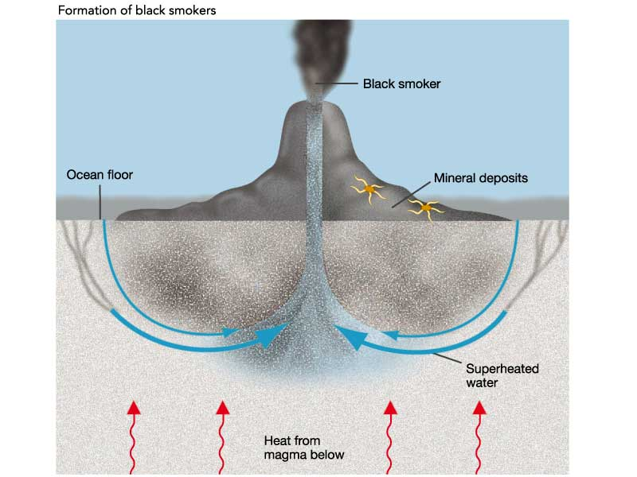

Slide 7
Why is salinity less along the equator and greater in the subtropics?
Average salinity: 35%o
Salinity worldwide normally varies between 34%o – 37%o due to atmospheric conditions above the water and volume of freshwater inflows
Equatorial waters – salinity lower than average (34.5%)
Subtropical oceans- salinity is more concentrated, increasing to 36%o
> 34%o salinity – brine e.g. Sargasso Sea, Persian Gulf
Brine lakes along the floor of the Red Sea and the Mediterranean Sea –salty 225%o
< 35%o salinity – brackish e.g. Baltic Sea, Gulf of Bothnia (avg. 10%) – ocean lower in salinity because of freshwater runoff and low evaporation rates

Slide 8
Global Oceans and Seas
Other reasons for Oceanic changes
High-latitude oceans have been freshening over the past decade – glacial ice melt
Oceanic acidification – hydrolysis forms carbonic acid which causes a lowering of the ocean pH
Average pH today is 8.2; could decrease by –0.4 to -0.5 units this century

Slide 9
The three general zones relative to physical structure within the ocean.
Physical Structure of the Ocean
The ocean's surface layer is warmed by the Sun and is wind-driven.
Layered
mixing zone; represents 2% of the oceanic mass – water temperature and solutes blended rapidly
thermocline transition zone; a region of strong temperature gradient that lacks the motion of the surface.
deep cold zone; salinity and temperature values are quite uniform. Temp. 0ºC, but due to its salinity, seawater freezes at -2ºC ; coldest water at the bottom except near the poles

Slide 10
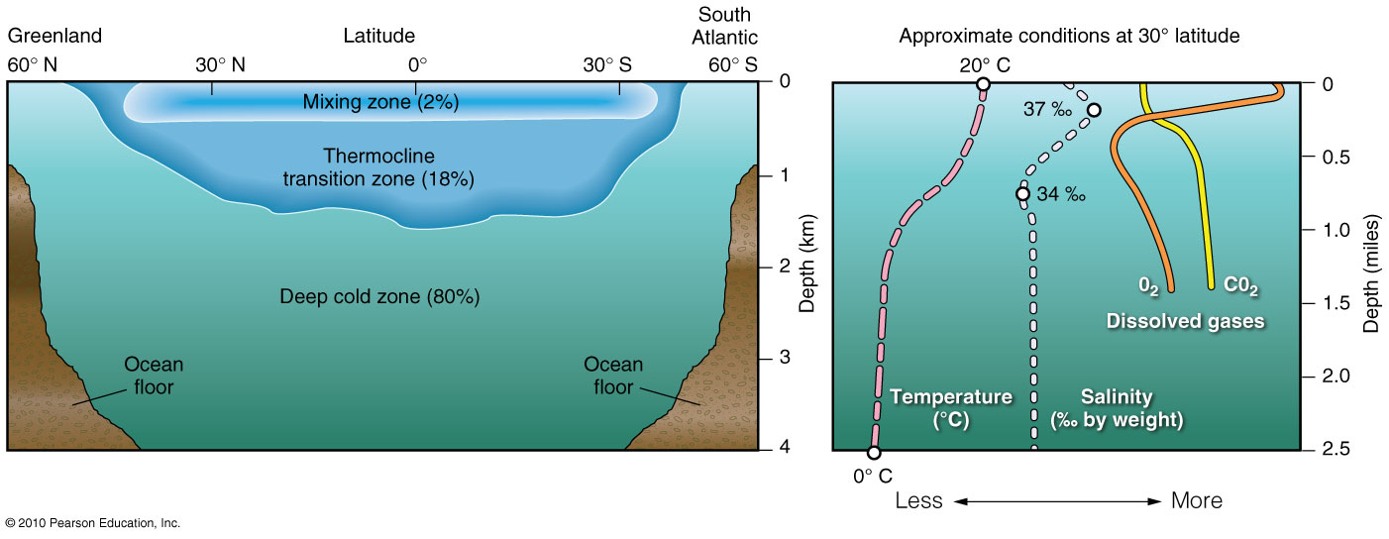
Ocean’s Physical Structure – Characterized by temperature, salinity, dissolved oxygen, and dissolved carbon dioxide.
Figure 13.2

Slide 11
Key terms used to describe the Coastal Environment
The land, ocean, atmosphere, Sun, and Moon interact to produce tides, currents, waves, erosional features & depositional features
The Coastal Environment is called the littoral zone
spans both land and water; Landward, it extends to the highest water line that occurs on shore during a storm. Seaward, it extends to the point at which storm waves can no longer move sediments on the seafloor at depths of about 60m
Shoreline: specific contact line between the sea and the land
Coast: land adjacent to the shoreline

Slide 12
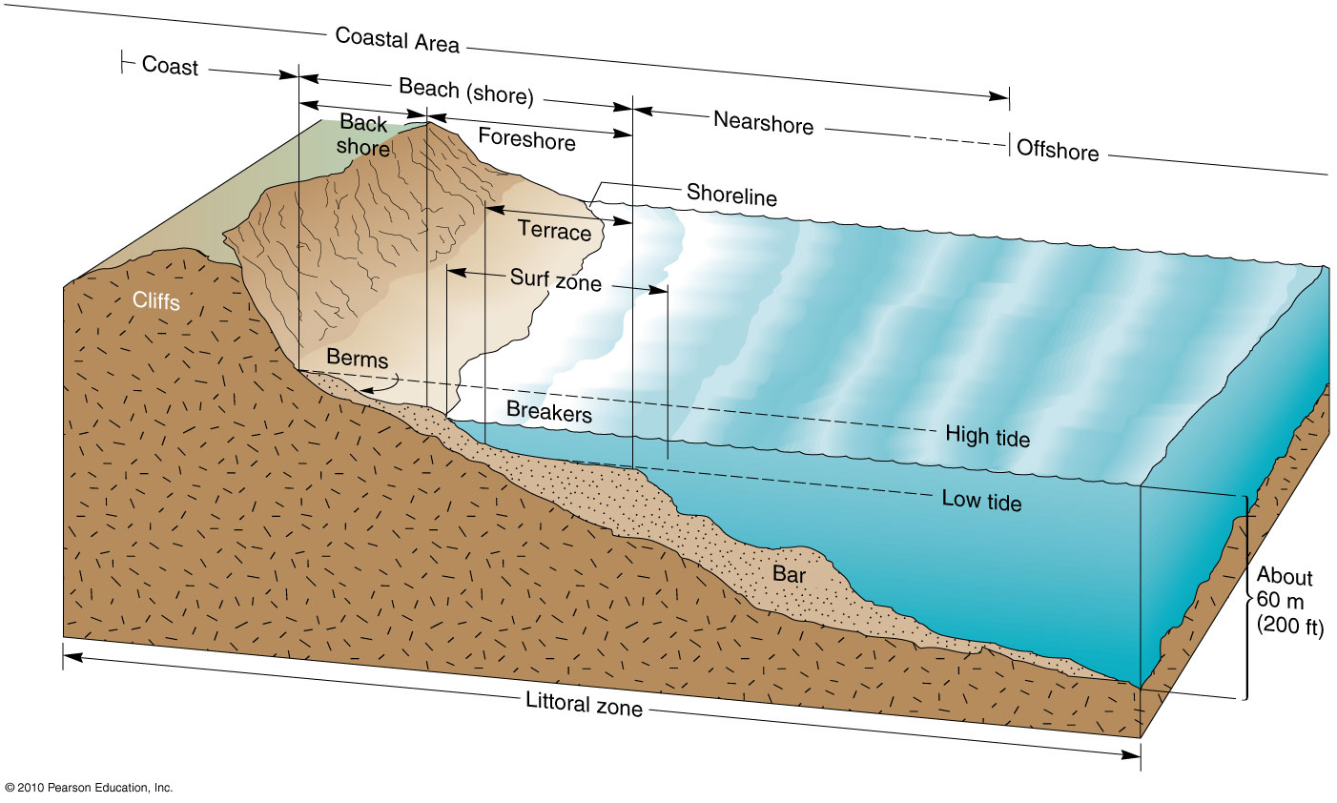
Littoral Zone includes the Coast, Beach and Nearshore environments
Figure 13.3

Slide 13
Define mean sea level. How is this value determined? Is it constant or variable around the world?
Mean sea level is a calculated value based on average tidal levels recorded hourly at a given site over a period of years. Mean sea level varies spatially from place to place because of ocean currents and waves, tidal variations, air temperature and pressure differences, and ocean temperature variations.

Slide 14
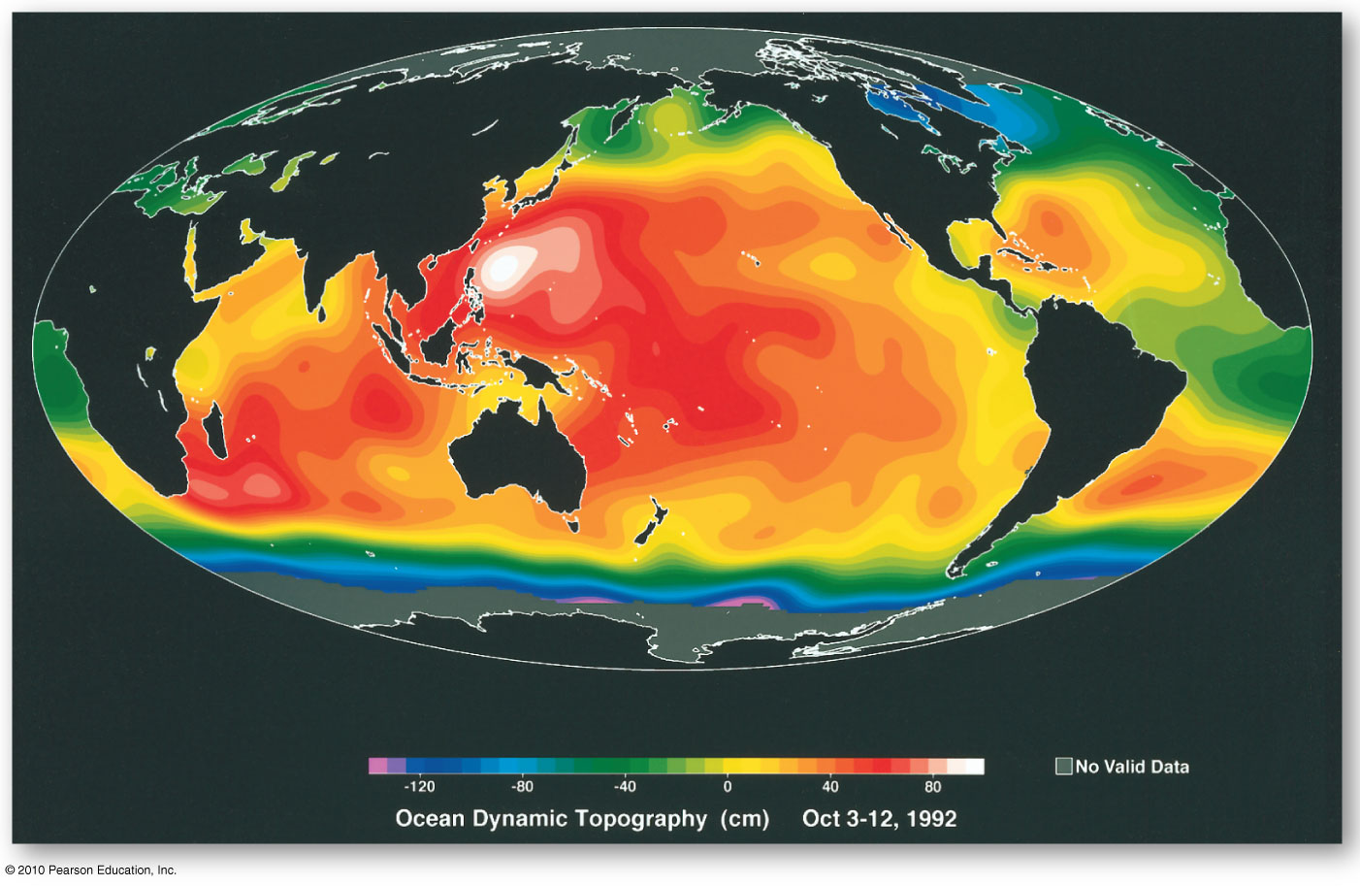
Ocean Topography
Figure 13.4
Christopherson, Elemental Geosystems, Sixth Edition
Copyright © 2010 Pearson Education, Inc.

Slide 15
Interacting forces that generate the patterns of Tides
Earth's orientation to the Sun and the Moon (astronomical relationships) produce the pattern of tides, the complex twice daily oscillations in sea level that are experienced to varying degrees around the world
Tides also are influenced by the size, depth, and topography of ocean basins, by latitude, and by shoreline configuration. Tides are produced by the gravitational pull exerted on Earth by both the Sun and the Moon.
Although the Sun’s influence is only about half that of the Moon (46%) it is still a significant force, even though the Sun is a greater distance from Earth

Slide 16
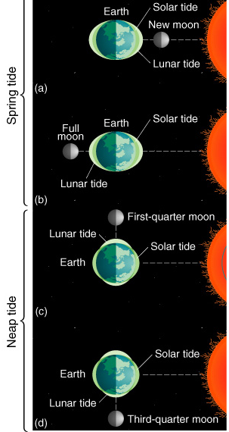
The Causes of Tides.
Gravitational relations of Sun, Moon, and Earth combine to produce the tides. Gravity and inertia are essential elements in understanding tides. Gravity is the force of attraction between two bodies. Inertia is the tendency of objects to stay still if motionless or to keep moving in the same direction if in motion. In the case of (a) for example, the corresponding tidal bulge on the Earth’s opposite side is primarily the result of far-side waters remaining in position (being left behind) because its inertia exceeds the gravitational pull of the Moon and Sun.

Slide 17
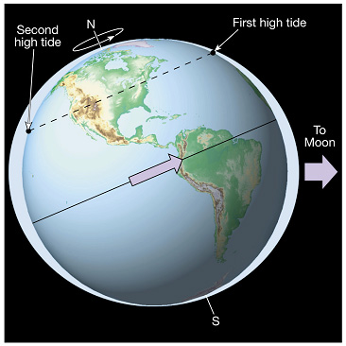
Tides are caused by the gravitational pull of the Moon
Tides

Slide 18
Tides
Daily elevation changes of ocean surface
Tidal bulges are caused primarily by the gravitational pull of the Moon, and the equal and opposite force of inertia
Pull is slightly greater on the near side of Earth than the far side
Earth rotates through tidal bulges
Tides shift about 50 minutes later each day

Slide 19
Tides
Spring and neap tides
Spring - occur near time of new and full moons
Gravitational forces of the Moon and Sun are added together for especially high, low tides
Largest daily tidal range
Neap - during first and third quarters of moon
Gravitational forces of Moon, Sun are offset
Least daily tidal range
Ocean basin shape (size, depth and topography) can influence tidal range

Slide 20
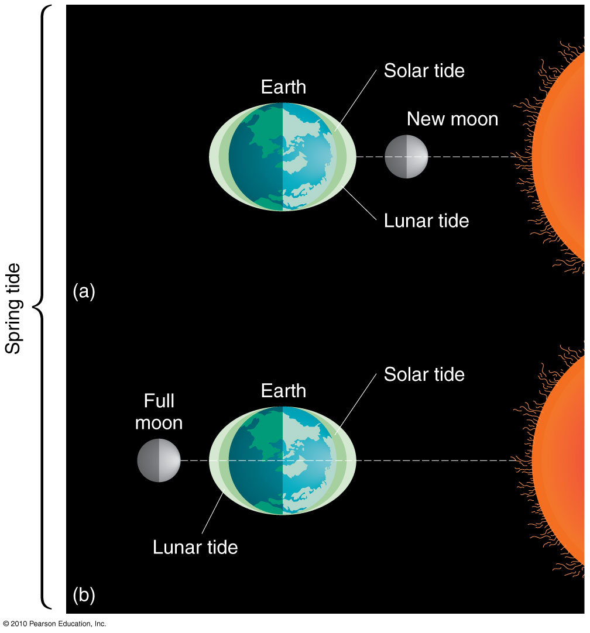
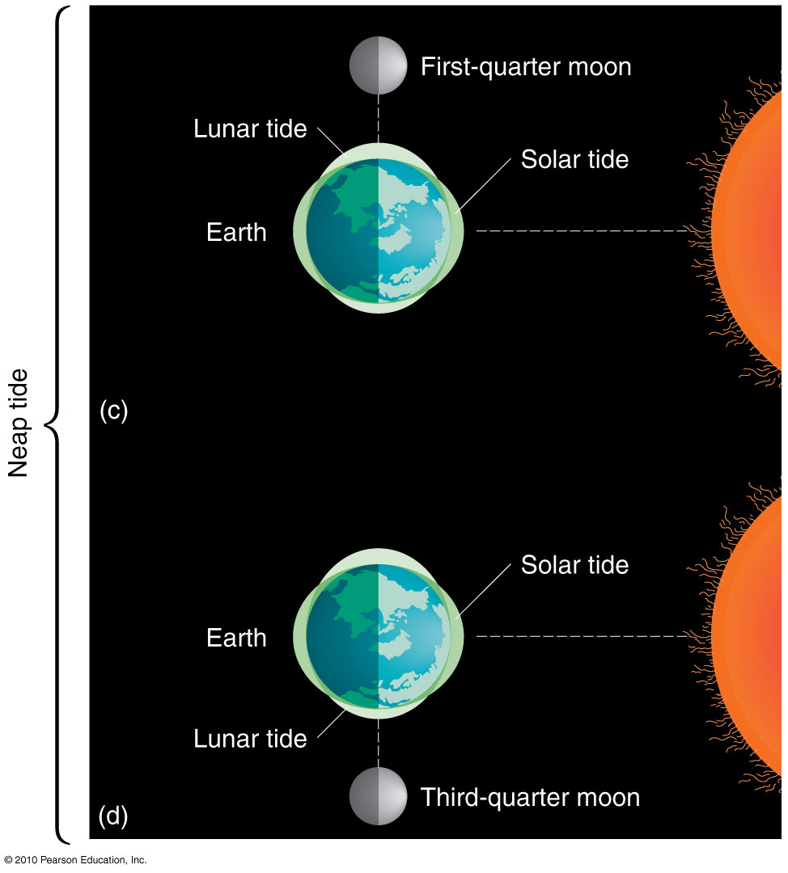
Tides
Figure 13.5

Slide 21
Do tides really move in and out along the shoreline?
Tides appear to move in and out along the shoreline, but they do not actually do so. Instead, the Earth’s surface rotates into and out of the relatively “fixed” tidal bulges as Earth changes its position in relation to the Moon and Sun. Hence, every day, most coastal locations experience two high (rising) tides, known as flood tides, and two low (falling) tides, known as ebb tides. The difference between consecutive high and low tides is considered the tidal range.

Slide 22
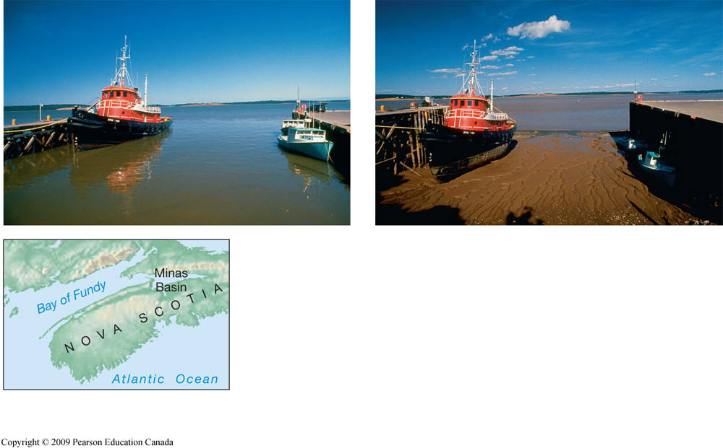
Tides
High tide and low tide on Nova Scotia’s
Minas Basin in the Bay of Fundy
High and low tide in the narrow Minus Basin, Bay of Fundy, Nova Scotia.

Slide 23
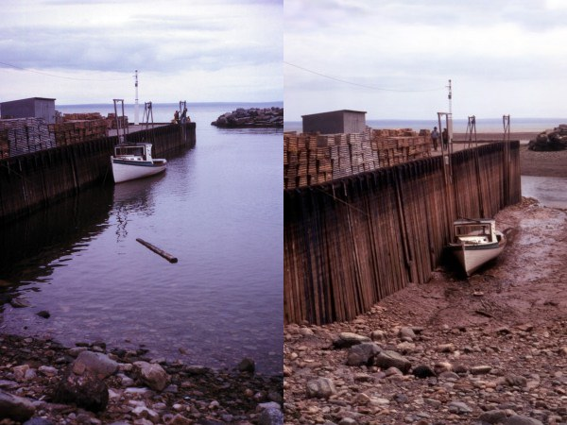
Bay of Fundy at high and low tide

Slide 24
Tidal Power being used to generate electricity.
The fact that sea level changes daily with the tides suggests an opportunity that these could be harnessed to produce electricity.
The bay or estuary under consideration must have a narrow entrance suitable for the construction of a dam with gates and locks, and it must experience a tidal range of flood and ebb tides large enough to turn turbines, at least a 5m range.
Tidal power generation is possible at about 30 locations in the world
at present only two of them are actually producing electricity: an experimental 1 megawatt station in Russia at Kislaya-Guba Bay, on the White Sea, since 1969;
and a facility in the Rance River estuary on the Brittany coast of France since 1967.

Slide 25
Tidal Power being used to generate electricity.
According to studies completed by the Canadian government, the present cost of tidal power at ideal sites is economically competitive with that of fossil fuels, although certain environmental concerns must be addressed. Among several favorable sites on the Bay of Fundy:
one plant is in operation, The Annapolis Tidal Generating Station - built in 1984 to test electrical production using the tides. Nova Scotia Power Incorporated operates the 20 megawatts plant.

Slide 26
Waves and Waves generation
Undulations of ocean water called waves travel in wave trains, or groups of waves.
Storms around the world generate large groups of wave trains. A stormy area at sea is the generating region for these large waves, which radiate outward from their formation center.
As a result, the ocean is criss­crossed with intricate patterns of waves traveling in all directions.
The waves seen along a coast may be the product of a storm center thousands of kilometers away.
Water within such a wave is not really migrating but is transferring energy through the water in simple cyclic undulations, which form waves of transition.
In a breaker, the orbital motion of transition gives way to waves of translation, in which both energy and water move forward toward shore as water cascades down from the wave crest

Slide 27
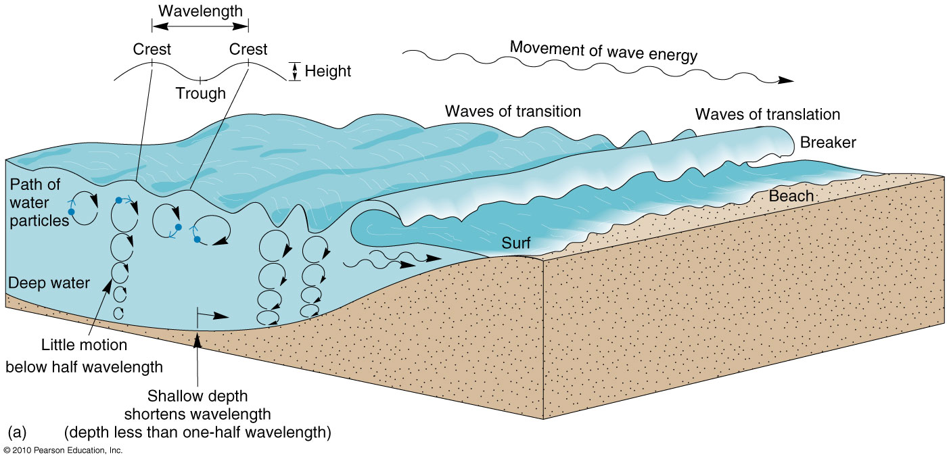
Wave Formation
Figure 13.7

Slide 28
Waves
Wave characteristics
Waves derive their energy and motion from the wind
Measurements of a wave
Wave period – the time interval between the passage of two successive crests
Height, length, and period of a wave depend on
Wind speed
Length of time wind has blown
Fetch – the distance that the wind has travelled across open water

Slide 29
Waves
Waves in the surf zone
When water-depth is about one-seventh the wavelength, wave begins to “feel bottom”
As speed and wavelength diminish, the wave grows higher
The steep wave front then collapses and the wave breaks – waves of translation
Turbulent water advances up the shore and forms surf
Water moves up the beach slope as swash
Flows back down the beach as backwash
ripcurrent

Slide 30
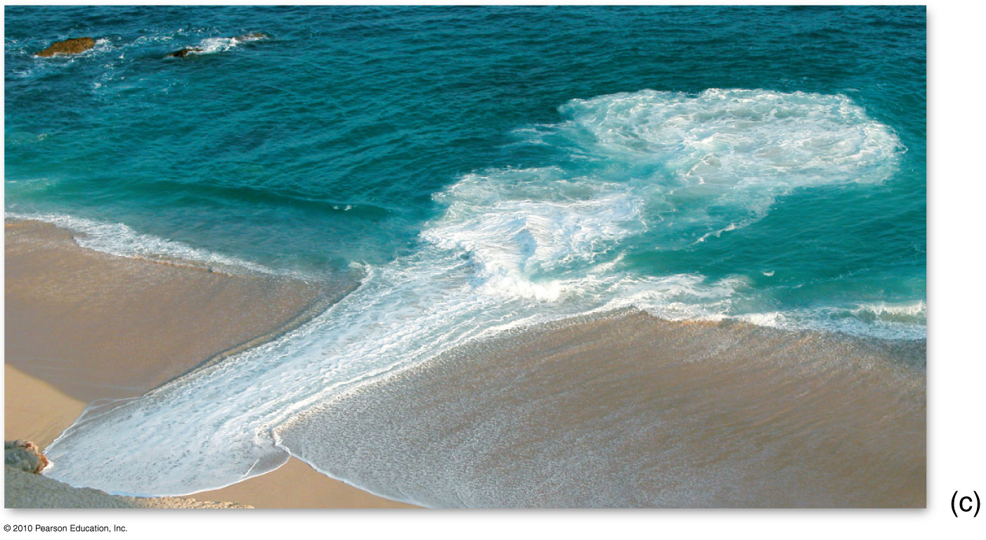
Rip Current

Slide 31
Describe the refraction process that occurs when waves reach an irregular coastline. Why is the coastline straightened?
Wave Refraction (bending)
Results in coastal straightening
Redistributes wave energy as it approaches an irregular coastline
Focus energy around headlands – wave attack (erosion)
Dissipate energy in coves and submerged coastal valleys (deposition of sediments)
This wave refraction (wave bending) along a coastline redistributes wave energy so that different sections of the coastline are subjected to variations in erosion potential.
Waves reach the coast at an angle

Slide 32
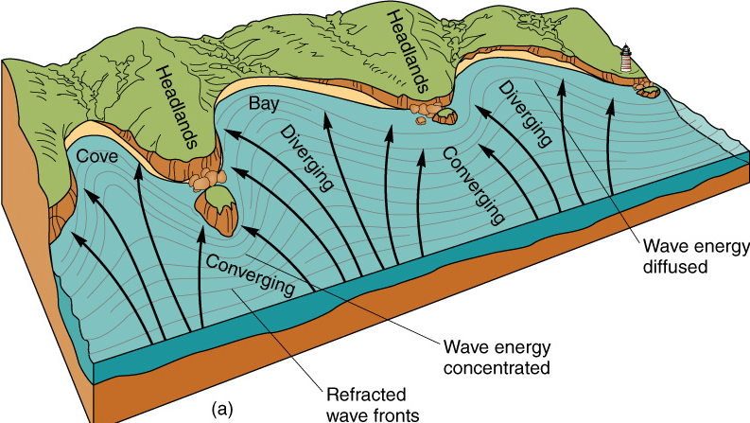
Coastal Straightening. The process of coastal straightening is brought about by wave refraction (deflection from a straight path). Wave energy is concentrated as it converges on headlands.
Figure 13.8
Christopherson, Elemental Geosystems, Sixth Edition
Copyright © 2010 Pearson Education, Inc.

Slide 33
The components of beach drift and the longshore current and longshore drift.
Particles on the beach are moved along as beach drift, or littoral drift, shifting back and forth between water and land in the effective wind and wave direction. These dislodged materials are available for transport and eventual deposition in coves and inlets and can represent a significant volume.
The longshore current transports beach drift. A longshore current generates only in the surf zone and works in combination with wave action to transport large amounts of sand, gravel, sediment and debris along the shore as longshore drift.

Slide 34
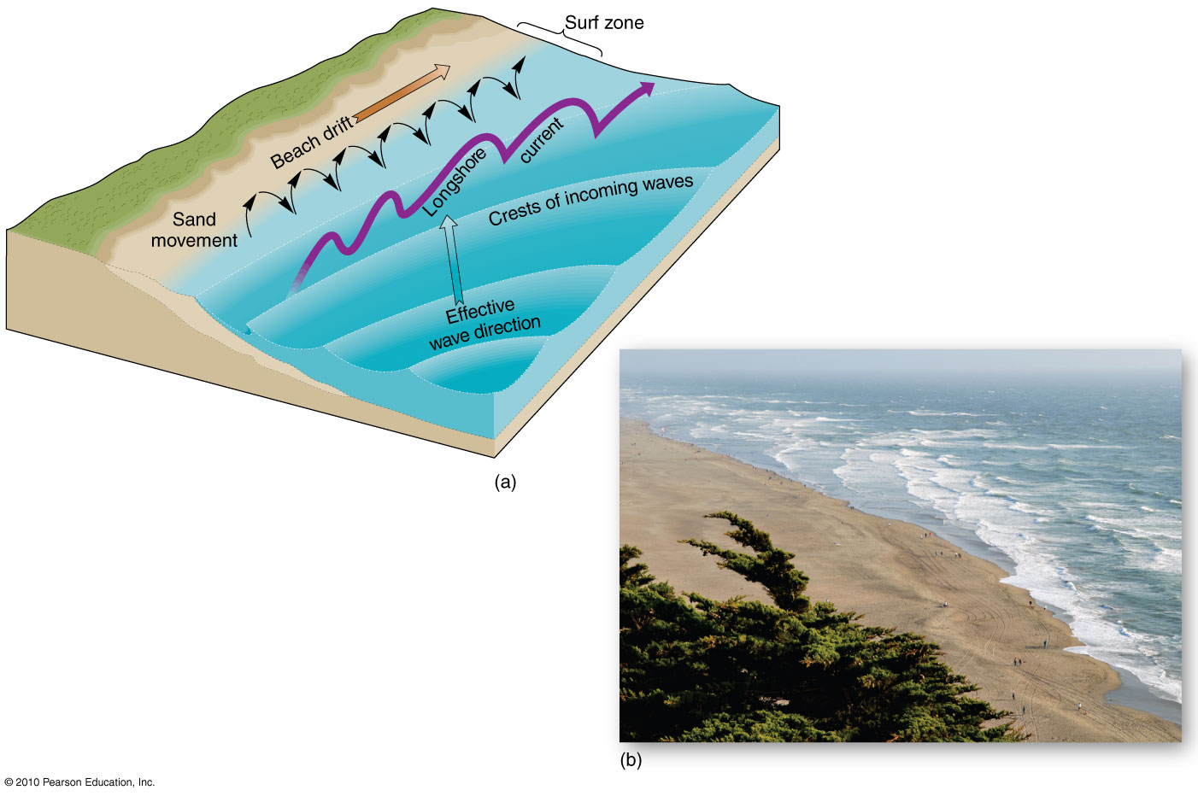
Longshore Current and Beach Drift
Figure 13.9
Christopherson, Elemental Geosystems, Sixth Edition
Copyright © 2010 Pearson Education, Inc.

Slide 35
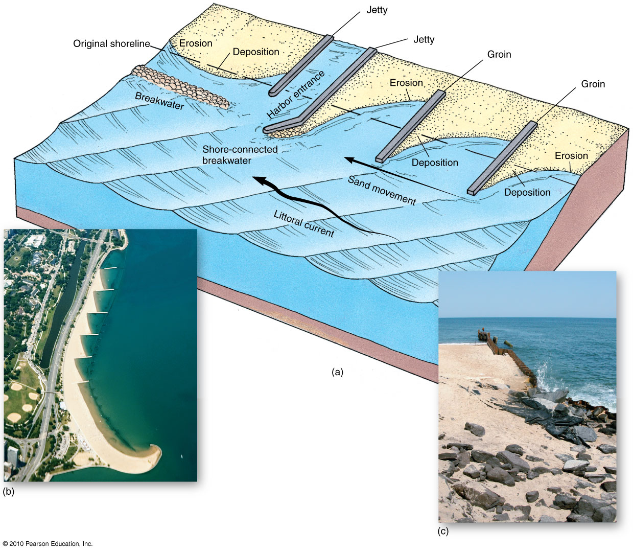
How do people modify littoral drift?
Figure 13.13
Christopherson, Elemental Geosystems, Sixth Edition
Copyright © 2010 Pearson Education, Inc.

Slide 36
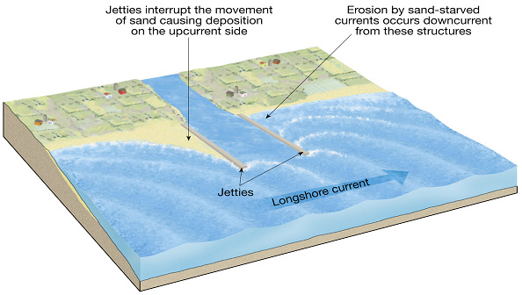
Stabilizing the Shore
Jetties are built to prevent deposition in navigation channels

Slide 37
Coastal System Outputs
Erosional Coastal Processes and Landforms
Depositional Coastal Processes and Landforms
Beaches
Barrier beach formations
Barrier island hazards
Biological Processes: Coral Formations
Coral reefs
Coral bleaching
Coastal Wetlands
Salt Marshes and Mangrove Swamps

Slide 38
Shoreline Features
Erosional features
Wave-cut cliffs
Wave-cut platform
Features associated with headlands
Sea arch
Sea stack

Slide 39
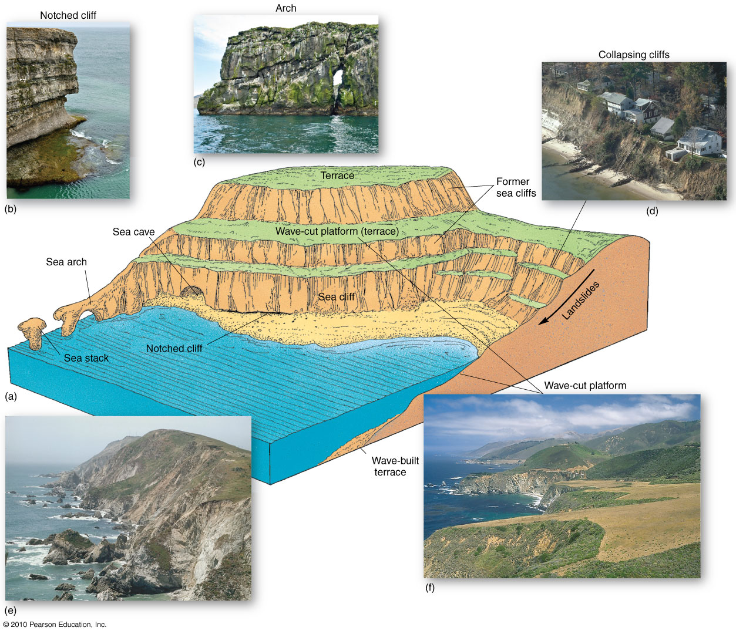
Erosional Features
Figure 13.10
Christopherson, Elemental Geosystems, Sixth Edition
Copyright © 2010 Pearson Education, Inc.

Slide 40
Shoreline Features
Depositional Coastal features
Beach (foreshore and backshore zones)
Foreshore is between low and high tide and affected by swash and backwash of breaking waves; backshore is above normal high tide
Place along the coast where sediment is in motion, deposited by waves and currents
Beach zone ranges, on average, from 5m above high tide to 10m below low tide

Slide 41
Shoreline Features
Depositional features
Spits - elongated ridges of sand extending from land into the mouth of an adjacent bay
Often the end of a spit hooks landward in response to wave-generated currents
Baymouth bar - sand bar that completely crosses a bay
Tombolo - ridge of sand that connects an island to the mainland or another island

Slide 42
Shoreline Features
Depositional features
Barrier islands – low ridges of land that parallel the shore
Separated from the shore by lagoons
Originate as spits, sand scoured from the bottom by waves, and Ice Age sand dunes
Tidal delta – created by tidal currents depositing sand into lagoons

Slide 43
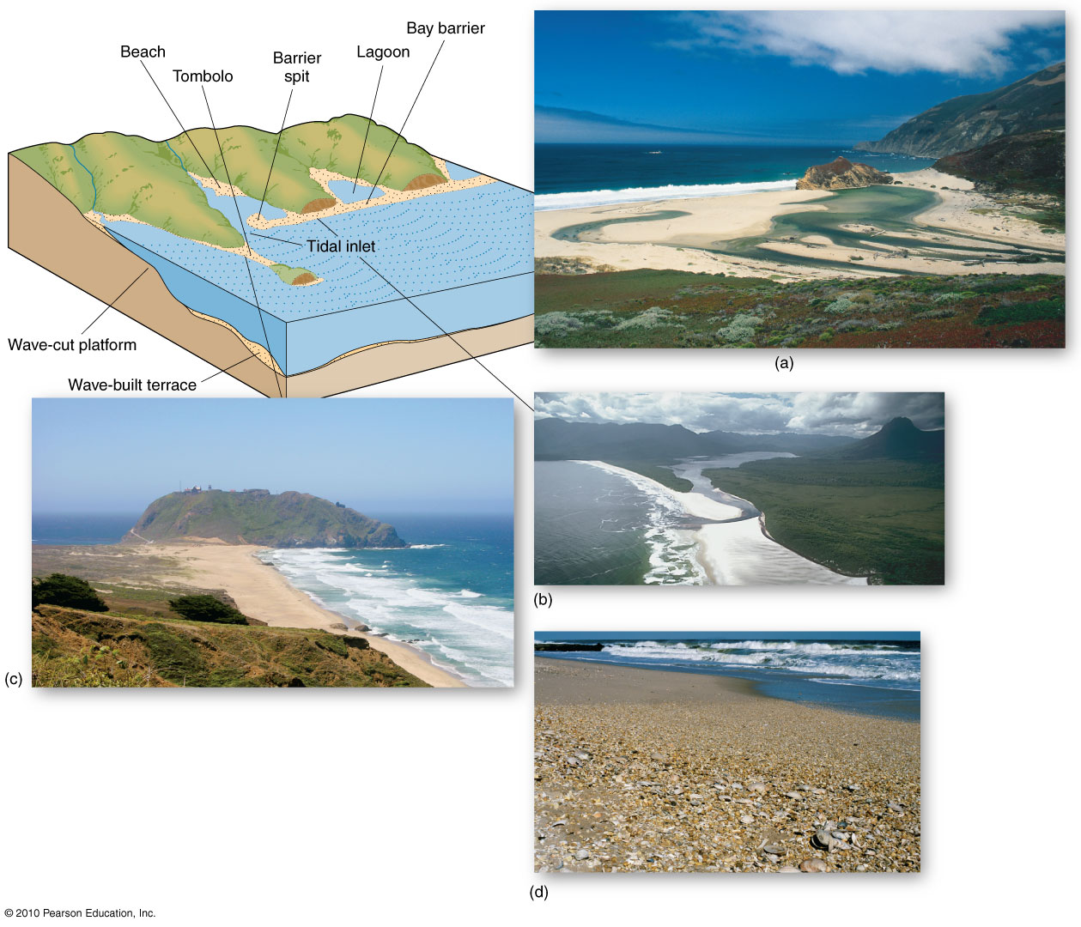
Depositional Coastal Features
Figure 13.12
Christopherson, Elemental Geosystems, Sixth Edition
Copyright © 2010 Pearson Education, Inc.

Slide 44
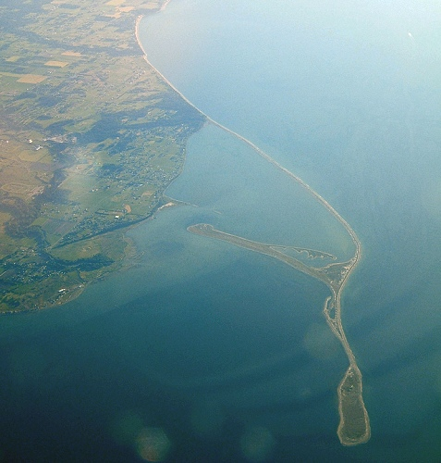
Dungeness Spit, Washington

Slide 45
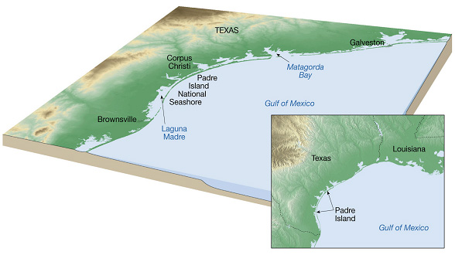
Shoreline Features
Barrier Islands along the Texas coast.

Slide 46
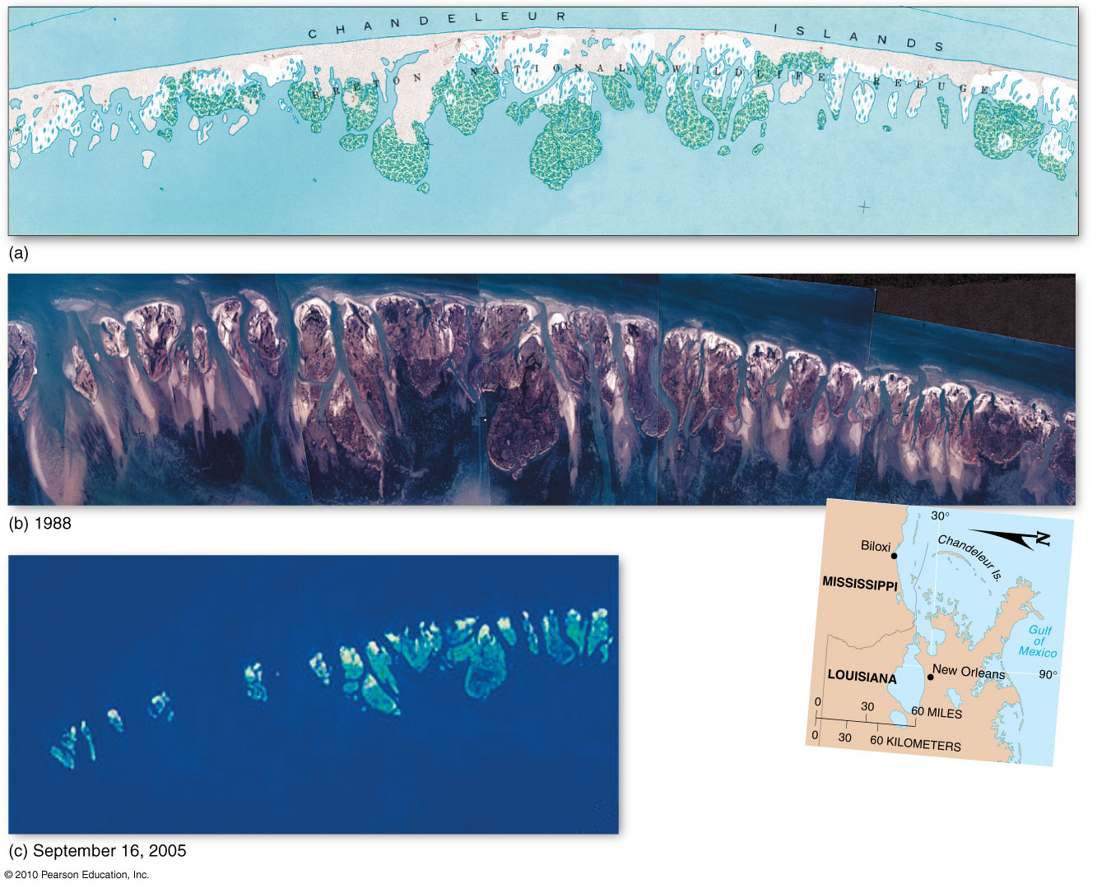
Chandeleur Islands
Figure 13.15

Slide 47
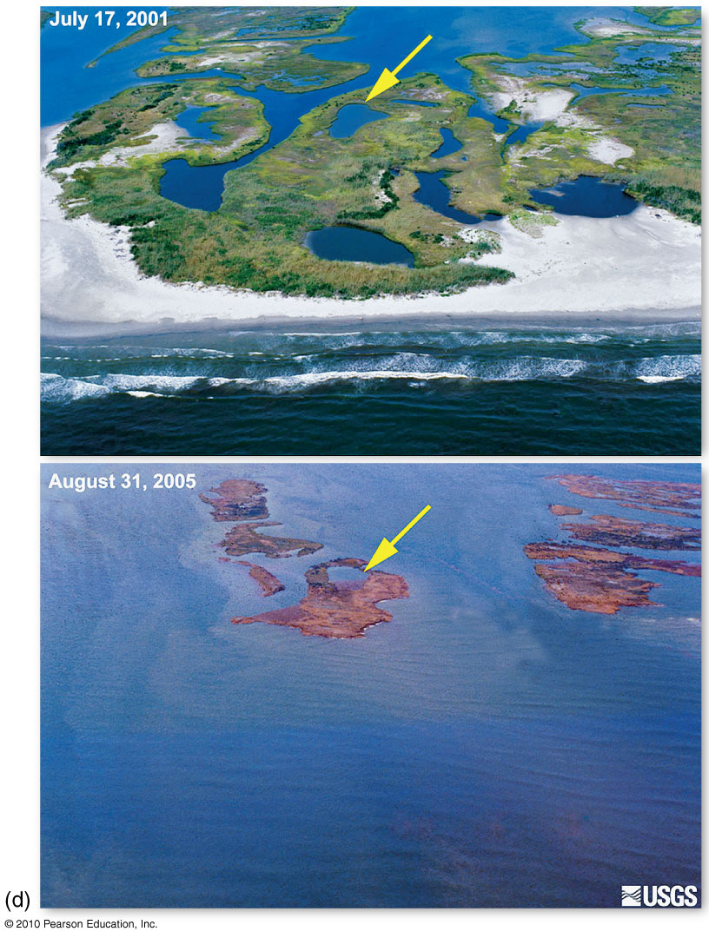
Chandeleur Islands
Figure 13.15
Notes:
47

Slide 48
Coral Reefs
Most diverse marine ecosystems
Living colonial corals range in distribution from about 30ºN to 30ºS
Specific ecological zone –
10m to 55m depth
27 to 40 parts per thousand salinity
18º to 29º C water temperature
Exception to this: unique species of cool corals that exist in dark, cold, water and deep ocean

Slide 49
Living Coastal Environments: Corals, wetlands, salt marshes and mangroves
Corals: prominent elements of some tropical coastal zones; reef growth favoured by:
Symbiotic relationship with algae
Low nutrient levels and normal salinity
Lots of light
Charles Darwin (1842) presented a hypothesis for reef formation
Reefs develop around volcanic islands; equilibrium maintained between subsidence of the island and the upward growth of coral

Slide 50
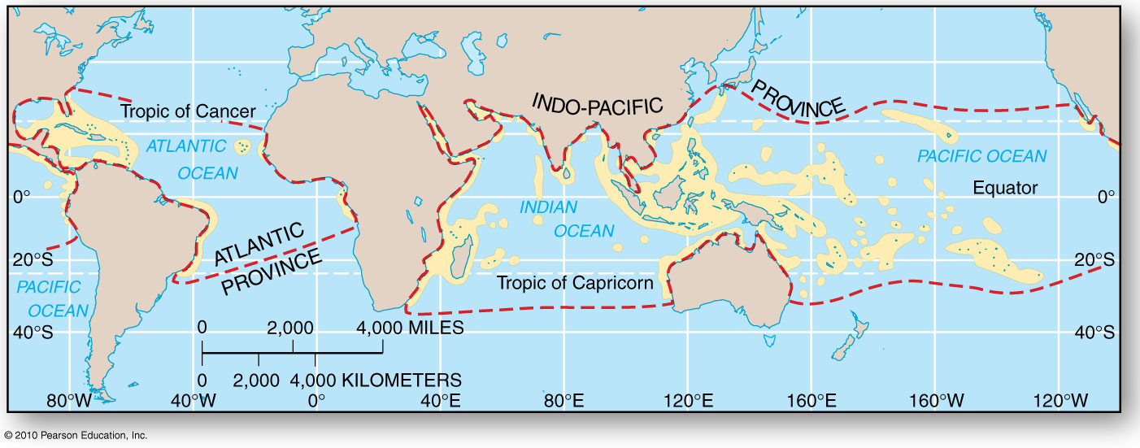
Coral Reef Distribution
Figure 13.17

Slide 51
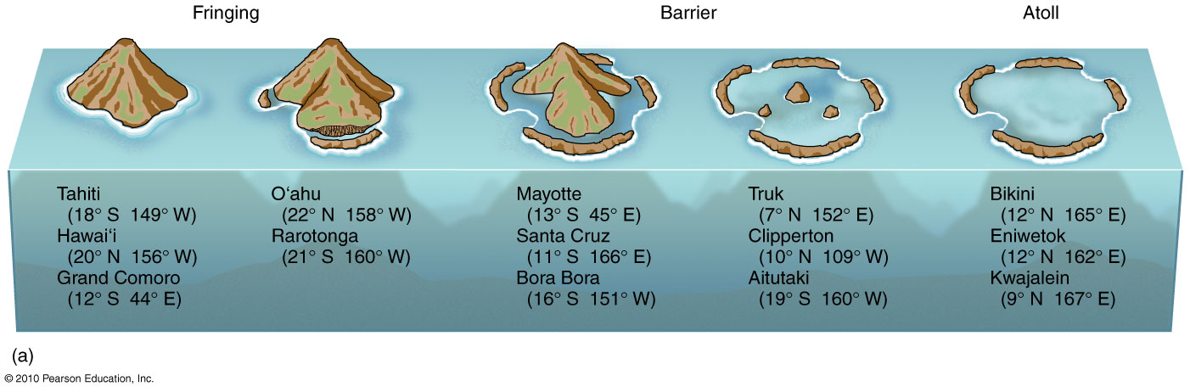
Coral Reef Formation and Forms
Figure 13.18

Slide 52
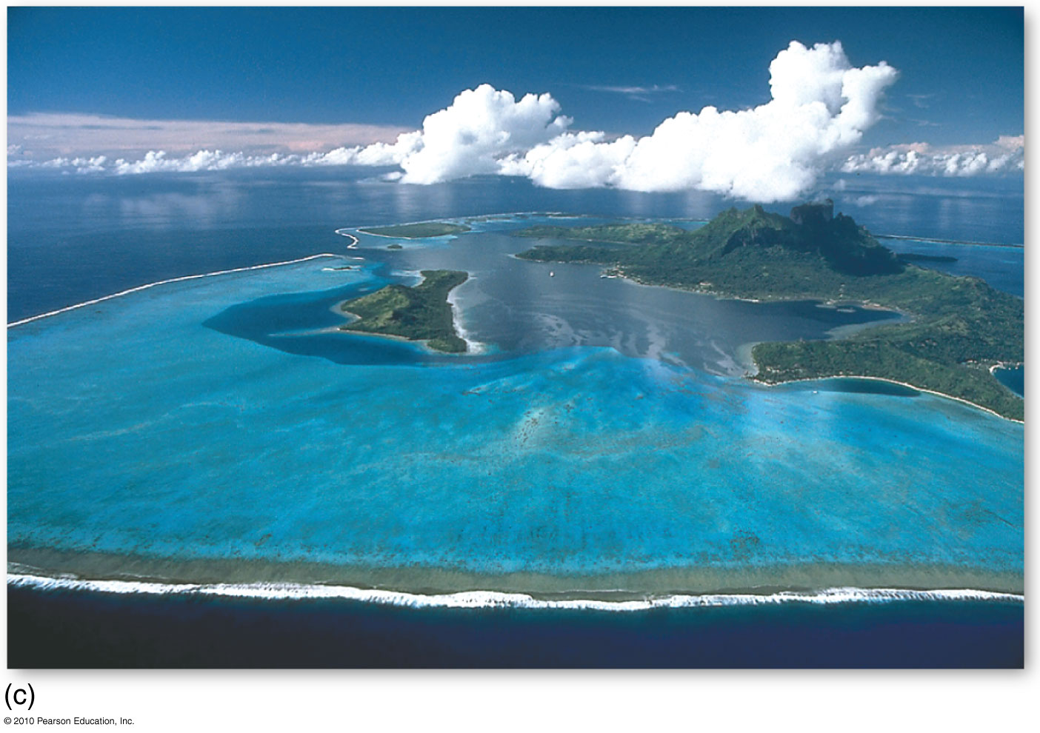
Coral Reef Formation
Aerial photograph of the atolls in Bora Bora, Society Is.

Slide 53
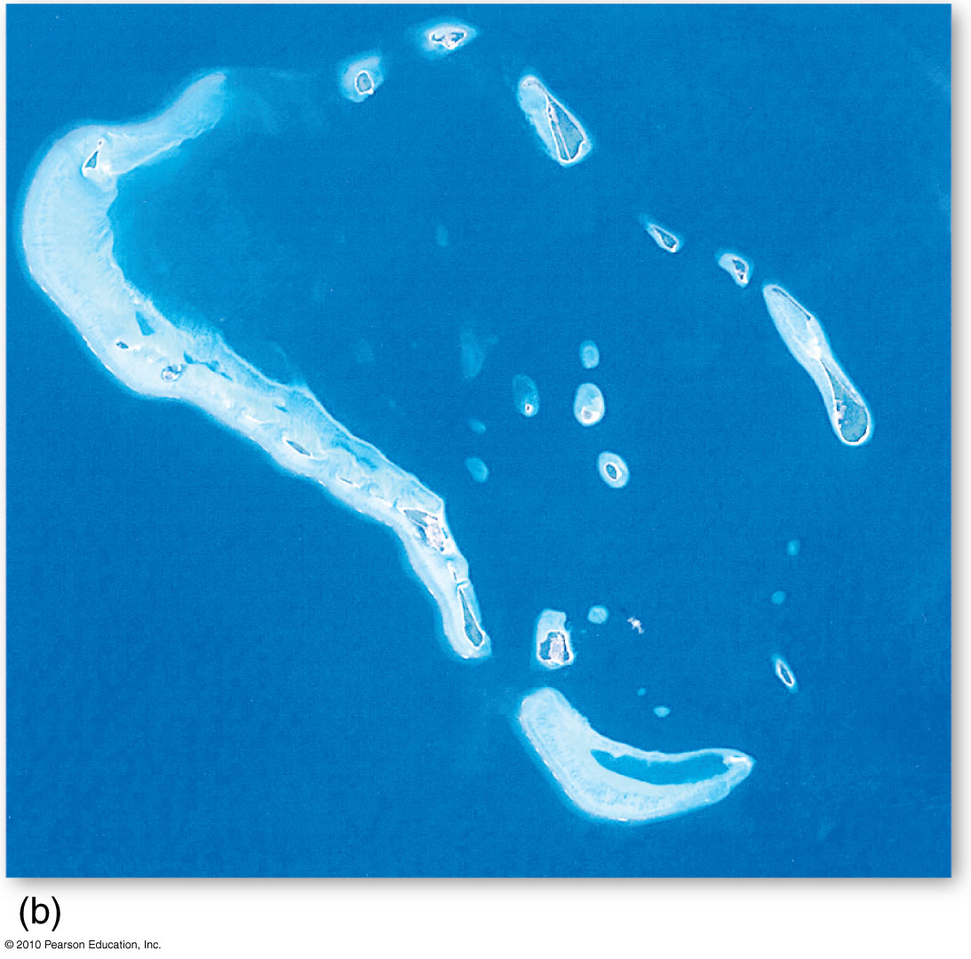
Coral Reef Formation
Satellite image of a portion of the Maldive Is.
in the Indian ocean

Slide 54
Wetlands, Salt Marshes, & Mangrove
Coastal wetlands
Saturated with water most of the time to support hydrophytic vegetation
Coastal areas with great biological productivity stemming from trapped organic matter & sediments
Wetlands ecosystems are quite fragile and threatened by human development; of 2 types
Salt marshes – N-hemisphere, north of the 30th parallel; usually form in estuaries and behind barrier beaches and sand spits. An accumulation of mud produces a site for the growth of halophytic (salt-tolerant) plants.
Mangrove swamps - Form equator-ward of the 30th parallel; Mangrove swamps often secure and fix enough material to form islands.

Slide 55
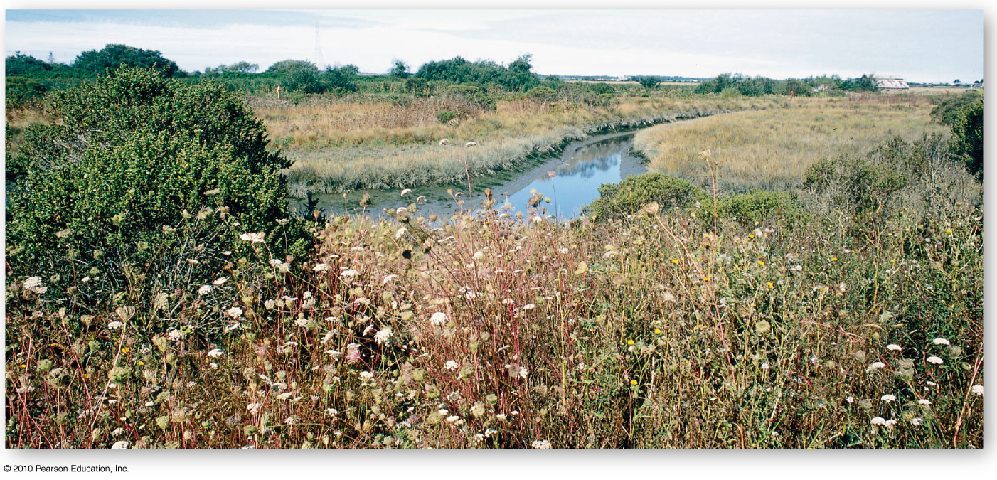
Coastal Salt Marsh
Figure 13.19

Slide 56
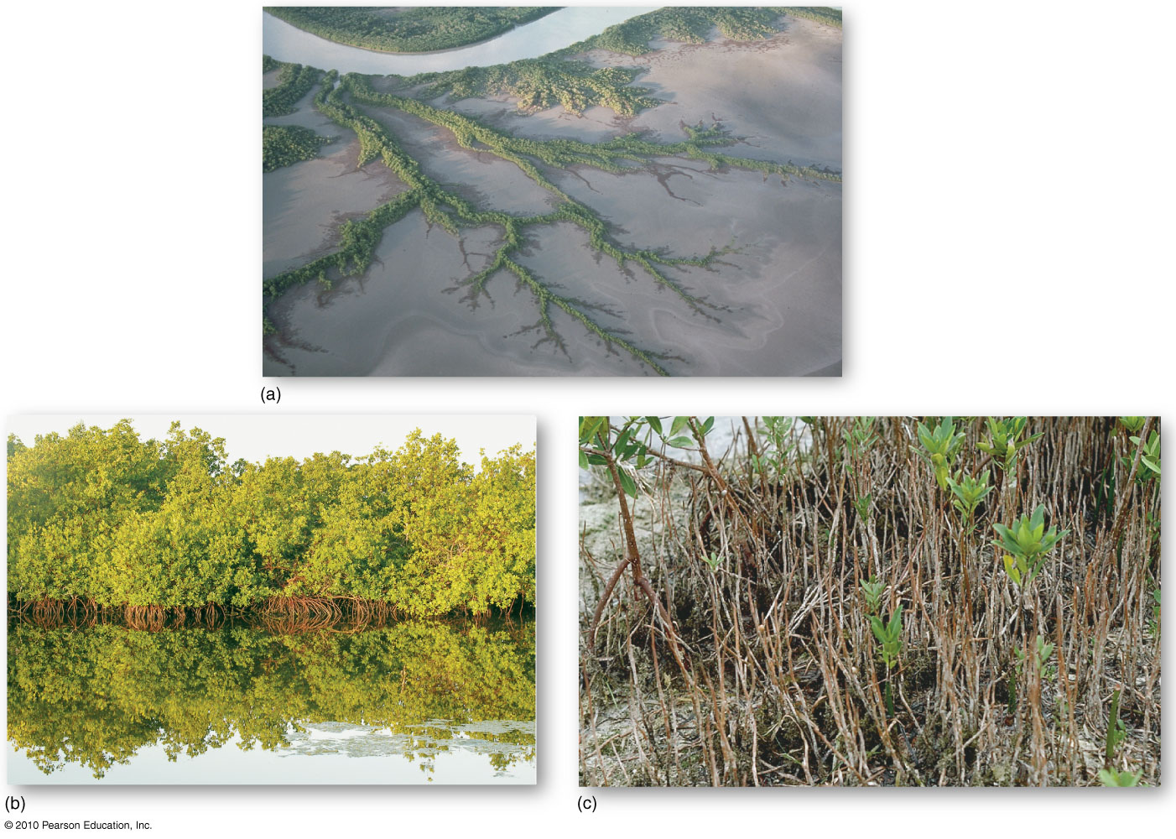
Mangroves
Figure 13.20
Christopherson, Elemental Geosystems, Sixth Edition
Copyright © 2010 Pearson Education, Inc.

Slide 57
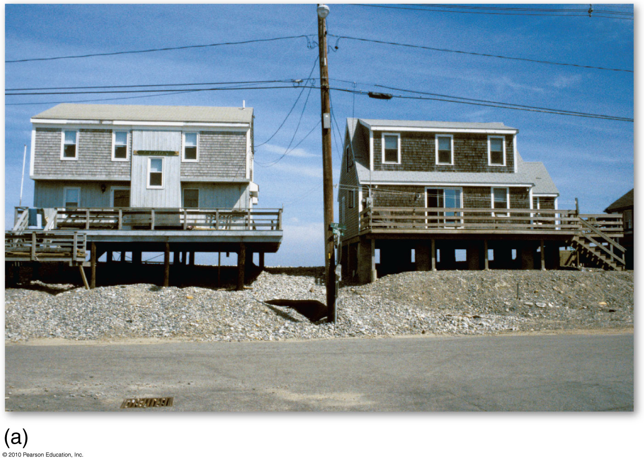
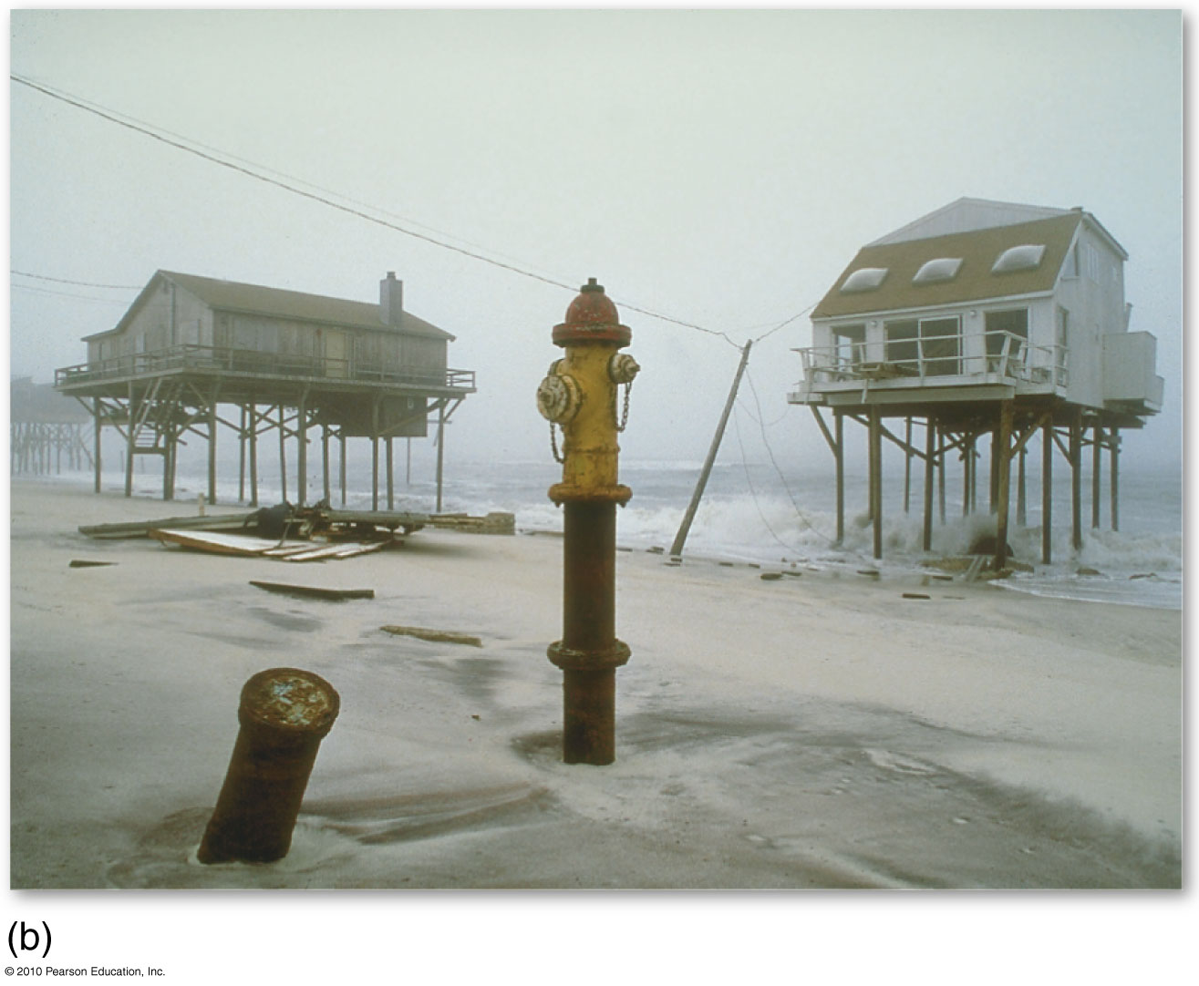
Beach Erosion
Figure 13.22
Christopherson, Elemental Geosystems, Sixth Edition
Copyright © 2010 Pearson Education, Inc.

Slide 58
The Work of Wind
The Work of Wind (Eolian)
Erosion
Transportation
Deposition

Slide 59
The Work of Wind
Eolian Erosion
Deflation – removal and lifting of individual particles
Landforms produced; desert pavement, blowout depressions
Abrasion – grinding of rock surfaces with a “sandblasting’ action by particles in the air
Landforms produced; ventifacts, yardangs

Slide 60
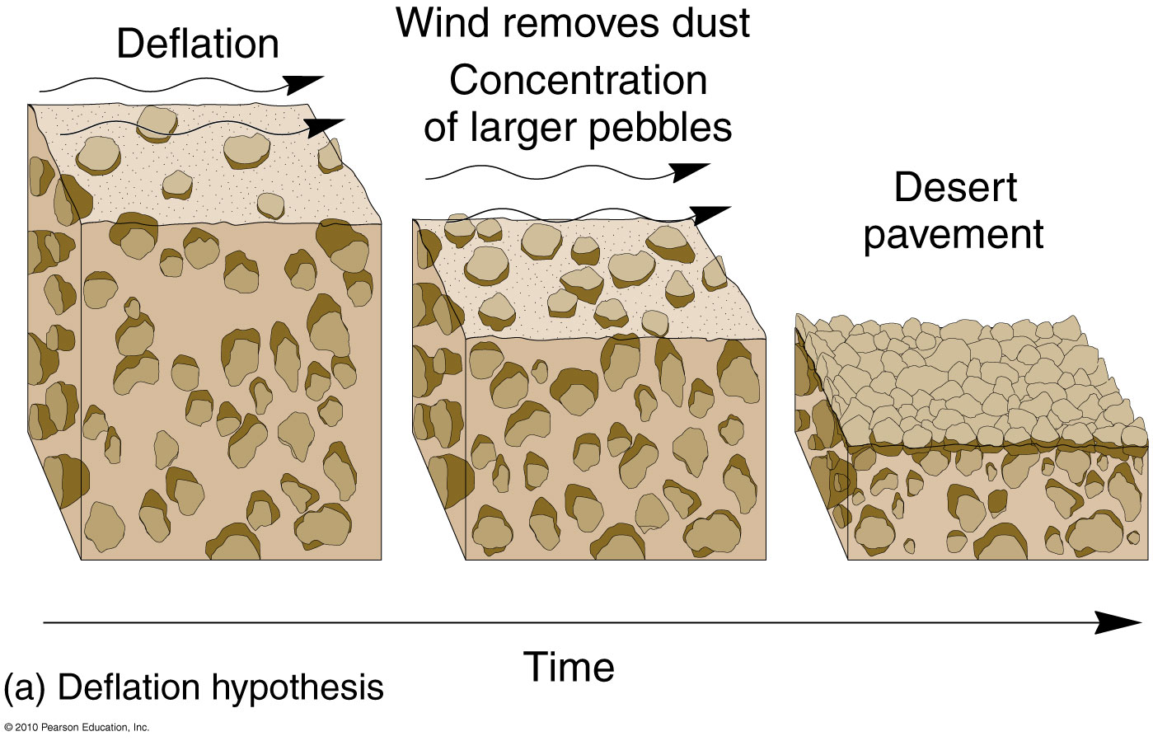
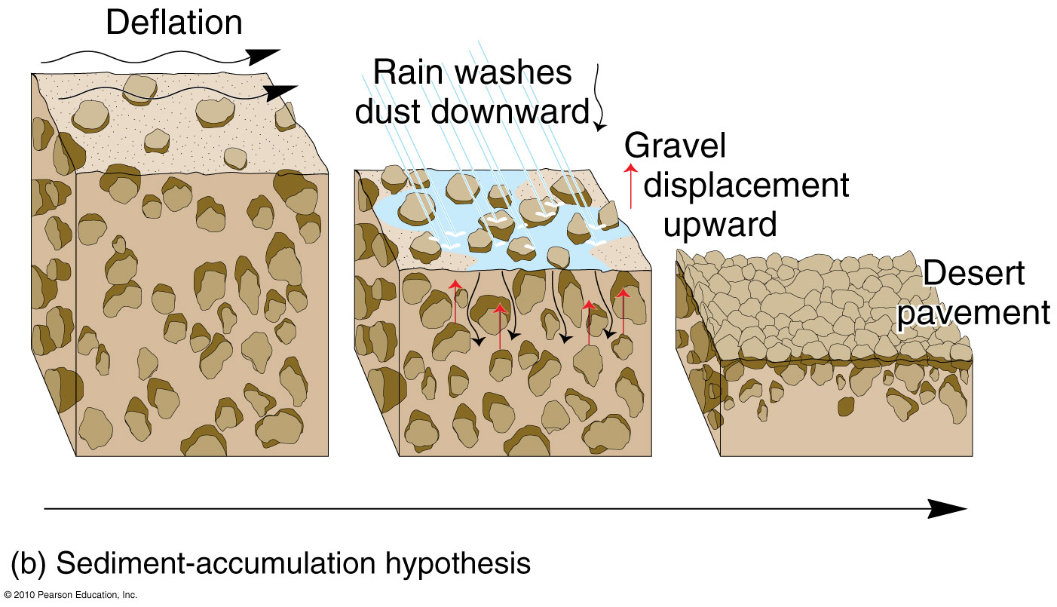
Desert Pavement Processes
Figure 12.2
Christopherson, Elemental Geosystems, Sixth Edition
Copyright © 2010 Pearson Education, Inc.

Slide 61
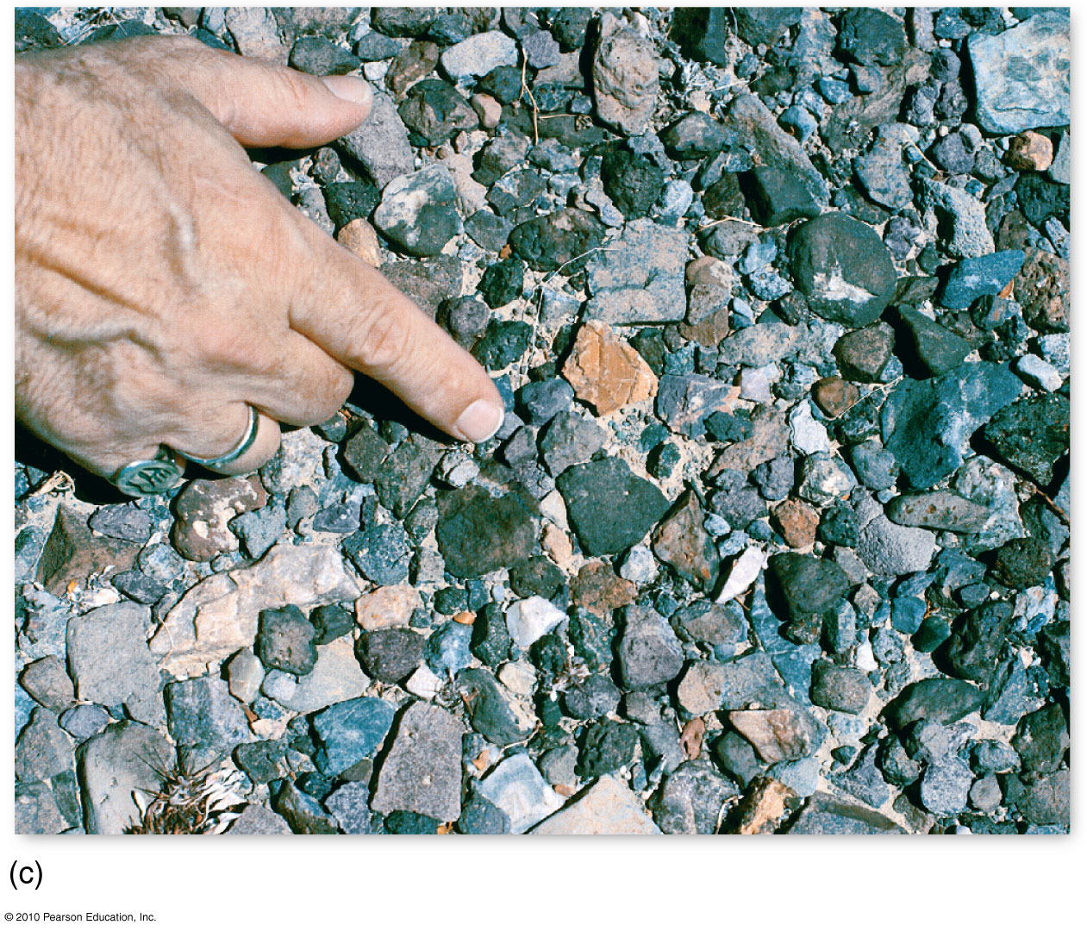
Desert Pavement
Figure 12.2

Slide 62
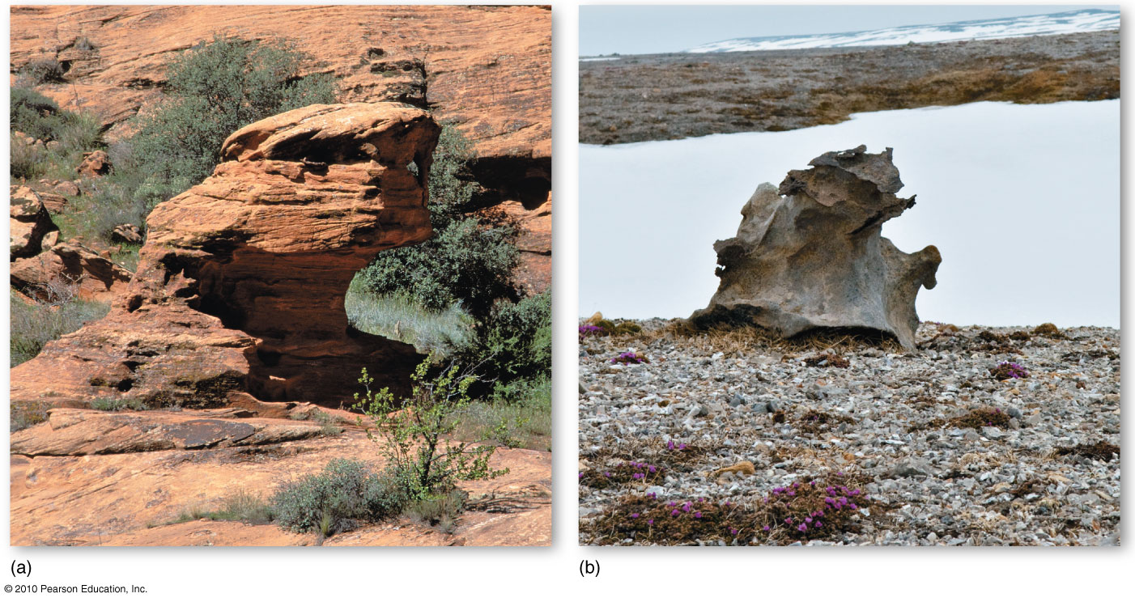
Yardang
Figure 12.3
Christopherson, Elemental Geosystems, Sixth Edition
Copyright © 2010 Pearson Education, Inc.

Slide 63
Eolian Transportation
Eolian Transportation
Dust storm
Sand storm
Particles move by saltation (aerodynamic lift, elastic bounce and impact), resulting in
surface creep (sliding & rolling of particles); affects about 20% of the material being transported

Slide 64
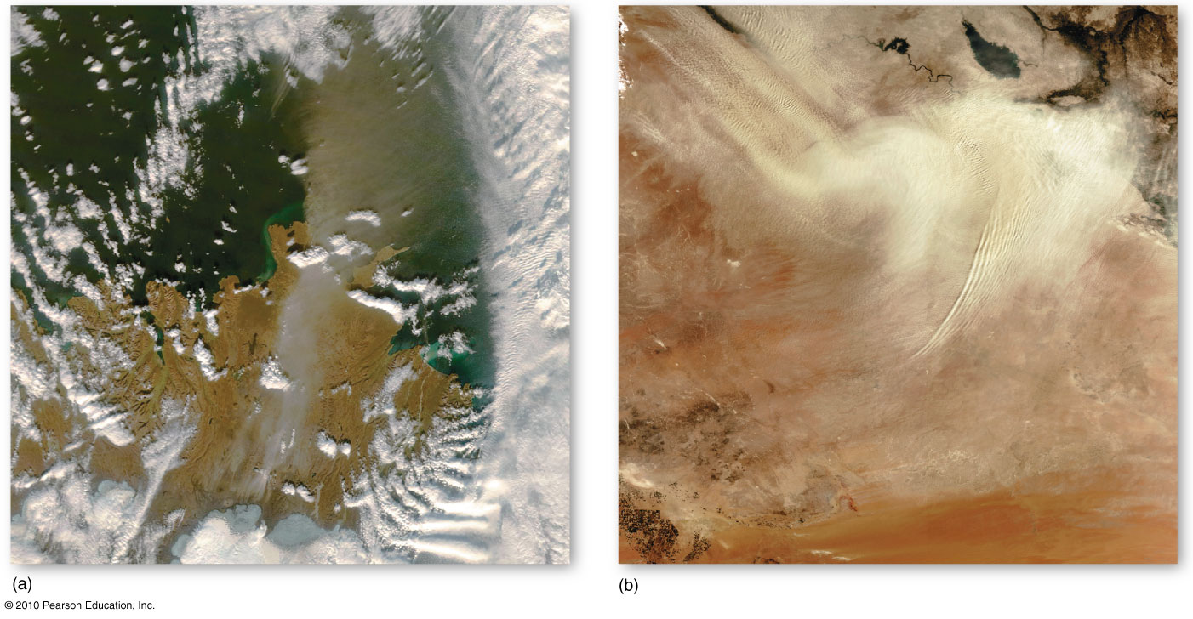
Dust storms in :
Iceland
Iraq

Slide 65
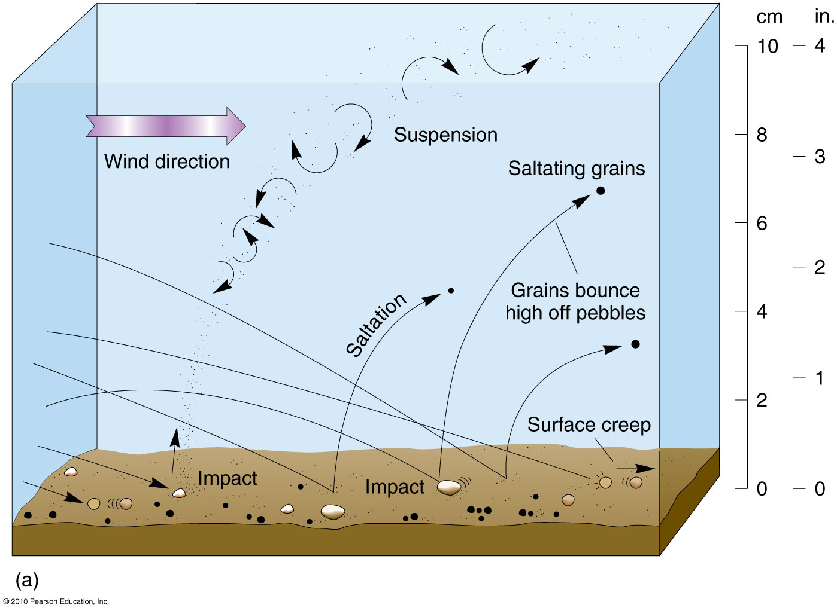
Sand Transport
Figure 12.5
Christopherson, Elemental Geosystems, Sixth Edition
Copyright © 2010 Pearson Education, Inc.

Slide 66
Eolian Depositional Landforms
Eolian Depositional Landforms
Eolian (sand) ripples
Sand cover only about 10% of desert landscapes; desert pavements predominate across most subtropical arid landscapes
Dunes: wind sculpted accumulation of sand e.g. erg desert in North Africa
Dune movement and form
cross section of a dune; dune migration

Slide 67
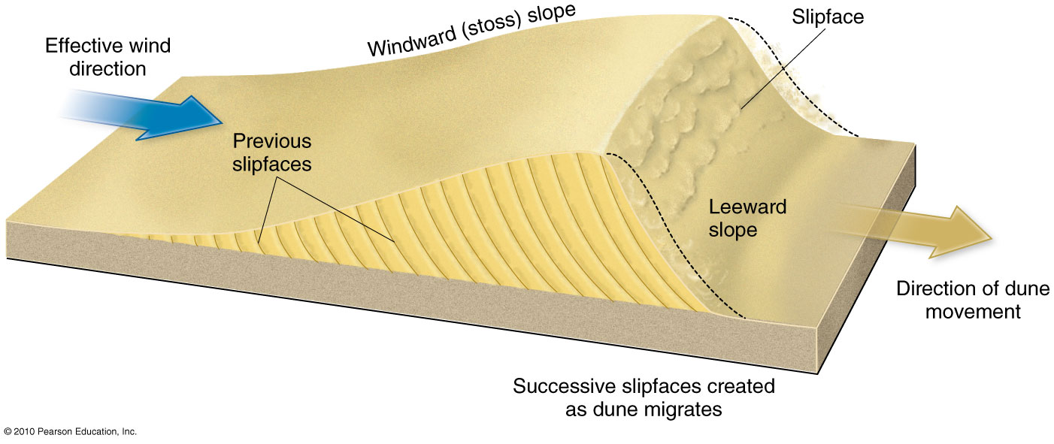
Dune Cross Section & Migration
Figure 12.9

Slide 68
Eolian Depositional Landforms
Free dunes vs. tied dunes
3 classes of dunes
Crescentic dunes
Barchan dunes (limited sand), transverse dunes ( abundant sand), parabolic dunes vegetation controlled)
Linear dunes
Longitudinal dunes and seif dunes
Star dunes
Mountainous giants of the sandy desert

Slide 69
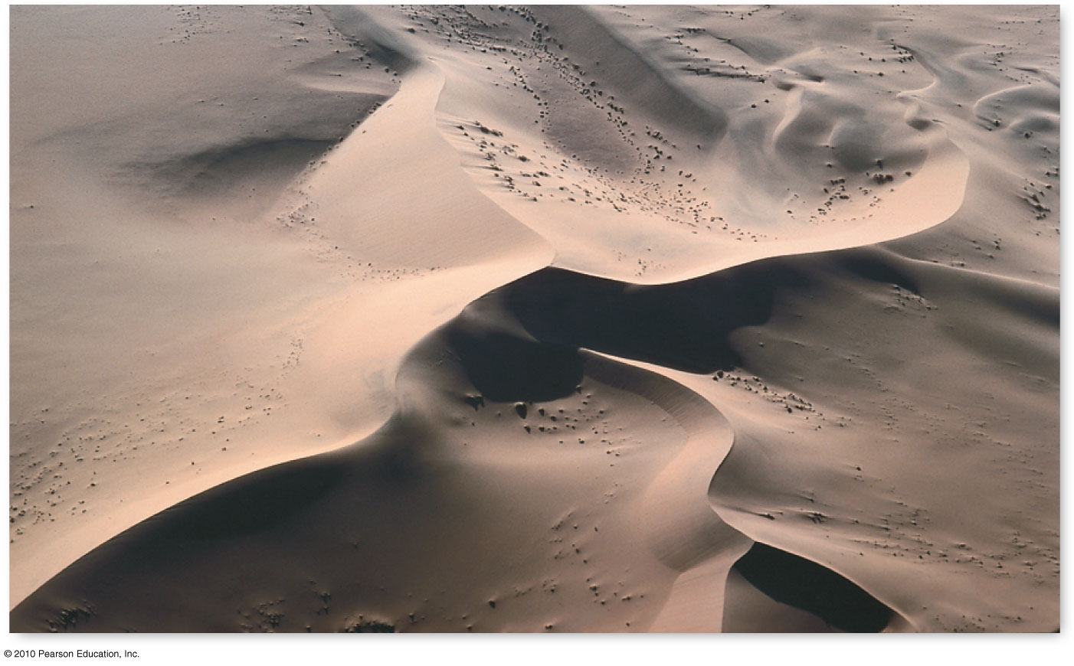
Star Dune – mountains of the desert
Namib desert of Namibia in southwestern Africa
Figure 12.11
Christopherson, Elemental Geosystems, Sixth Edition
Copyright © 2010 Pearson Education, Inc.

Slide 70
End of Lecture
Next Lecture
Chapter 13
Glacial & Periglacial Landscapes

